Slide 1

Earthquake Prediction System using machine Learning
Under the esteemed guidance of Sd.Rizwana, m.Tech, (P.hd)
Team Members:-
B. Bala Murali Krishna-19471A0571
M.Aditya-19471A05A3
R. Vijay Kumar-19471A05B4

Slide 2
CONTENTS
Abstract
Existing System
Proposed System
System requirements
Architecture
UML diagrams
Project Screenshots
Conclusion

Slide 3
Abstract
Earthquake prediction, the long-sought holy grail of earthquake science, continues to confound Earth scientists.
We used Google’s ML competition platform, Kaggle, to engage the worldwide ML community with a competition to develop and improve data analysis approaches on a forecasting problem that uses laboratory earthquake data.
The competitors were tasked with predicting the time remaining before the next earthquake of successive laboratory quake events, based on only a small portion of the laboratory seismic data.
In addition to yielding scientific insights into fault processes in the laboratory and their relation with the evolution of the statistical properties .
Different type of machine learning Algorthim are used to calculate the accuracy prediction of depth of the earthquake like Support Vector machine, Random Forest, Xboost

Slide 4
Existing System
Chemical composition of underground water was observed on a regular basis in seismically active regions and unusual animal behaviour .
(i) Concentration levels of dissolved minerals and gaseous components remained almost constant during seismically inactive period.
(ii) There are many methods that are used to predict earthquake like Water level rise, temperature changes, sesimometer.
Disadvantages:
Doesn’t generate accurate and efficient results.
It produces cost effective results
It require lot of technical support and man power to predict earthquake.

Slide 5
Proposed System
Proposed System
By using this system we can predict the accurate earthquake and can reduce damage moreover decline of deaths .The goal of earthquake prediction is to give warning of potentially damaging earthquakes early enough to allow appropriate response to the disaster, enabling people to minimize loss of life and property
Advantages:
Generates accurate and efficient results.
Computation time is greatly reduced.
Reduces manual work.

Slide 6
Algorithms used in proposed system
XG boost algorithm: Decision trees are utilized in this, and they are utilized in a jealous way, which alludes to picking the best-divided focuses in light of Gini Impurity and so forth or to limit the loss function. Gradient boosting is a supervised learning algorithm, which attempts to accurately predict a target variable by combining the estimates of a set of simpler, weaker models.
Random forest algorithm: The random forest algorithm is made up of a collection of decision trees, and each tree in the ensemble is comprised of a data sample drawn from a training set with replacement, called the bootstrap sample.
It takes less training time as compared to other algorithms.
Compared to XG boost algorithm Random forest as more accuracy in prediction of earthquakes
XG boost algorithm given the accuracy of 78% ,whereas random forest as accuracy of prediction 92%

Slide 7
System Requirements
Software Requirements
Hardware Requirements
Operating System : Windows10
Coding Language : Python
Python Distribution : Anaconda, Flask, Pycharm
System Type : Intel core I3
RAM : 8GB
Hard Disc : 1TB

Slide 8
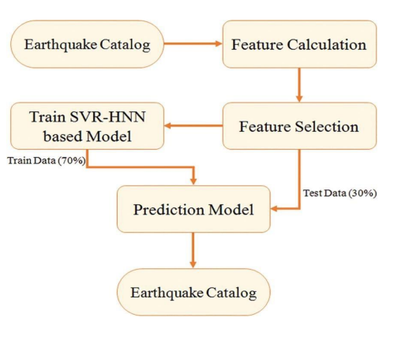
Architecture of proposed system

Slide 9
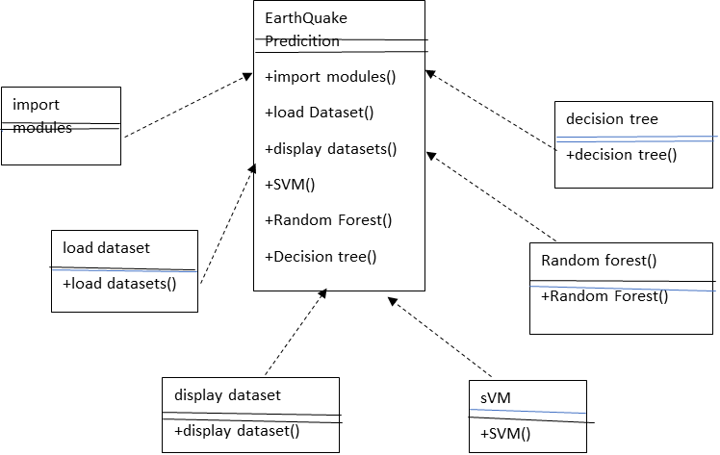
UML class diagrams

Slide 10
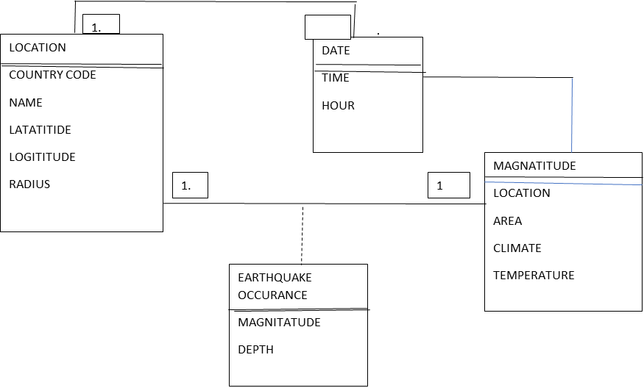
UML DIAGRAM FOR DATASET MODEL

Slide 11
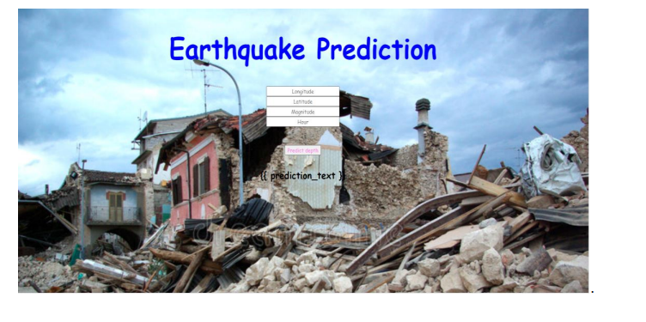
Project Screenshots

Slide 12
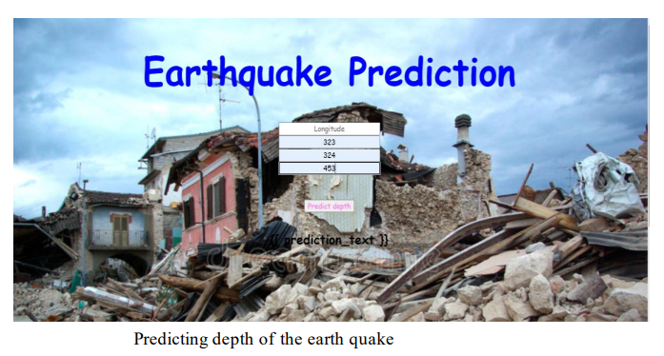

Slide 13
Conclusion
Thus it can be observed that by using the following algorithmic model for earthquake prediction, proper methods can be implemented for deploying warnings and preparing for earthquakes
From the above experiment results, random forest algorithm has high accuracy value when compared to all the other algorithms regarding house price predictions.
A number of clustering algorithms were used through the course of the research such as K-means and Hierarchical clustering. Hierarchical Clustering was found to be more efficient in terms of entropy but takes more processing time.

Slide 14


